Slide 1
Information Retrieval and Web Search
Vasile Rus, PhD
vrus@memphis.edu
www.cs.memphis.edu/~vrus/teaching/ir-websearch/

Slide 2
Outline
Administrivia
Why Information Retrieval?
Information Overload

Slide 3
General Information
Web Site:
http://www.cs.memphis.edu/~vrus/teaching/ir-websearch/
Instructor
Vasile Rus, PhD
Office: 323 Dunn Hall
Office Hours: 323 Dunn Hall; T-R 10:00-11:00AM
Phone: x5259
E-mail: vrus@memphis.edu
TA
Shanshan Gao
Office hours: TBD

Slide 4
Why Attending this Class ?
will help you cope with the information overload problem
will allow you to design and implement solutions for handling large collections of information
is FUN! (hopefully)

Slide 5
Syllabus
Week 1: Introduction to IR and Web Search
Week 2: Introduction to PERL
Week 3: Classic IR: Boolean and Vectorial Models
Week 4: More IR Models
Week 5: Evaluation in IR
Week 6: Query Operations and Languages
Week 7: Text Properties, Text Operations
Week 8: NO CLASS – FALL BREAK, Indexing and Searching, Review
Week 9: MIDTERM, WWW and Web Search Intro

Slide 6
Syllabus (cont’d)
Week 10: Web Search
Week 11: Text Categorization
Week 12: Text Clustering
Week 13: Question Answering
Week 14: Advanced IR Models, THANKSGIVING HOLIDAY
Week 15: Project Presentations, Review
Week 16: Final Exam

Slide 7
To be successful you need to
Read the syllabus
Understand the structure of the course
Read the general policies
Attend classes and participate by asking questions or/and contributing with related remarks
Explore the course website

Slide 8
To be successful you need to
Try to enjoy the programming assignments
Don't limit yourself to what is asked in class

Slide 9
Grading
Assignments
6-8 (or more)
Assignments: 35%
Project (30%)
2 Exams
Midterm (15%)
Final (15%)
Active Participation, Presentations (5%)

Slide 10
Grading
Grade | Letter Grade
90-100+ | A
80-89 | B
70-79 | C
60-69 | D
0-59 | F
2.5 above or below the cut-off will earn you a + or – in front of your grade.
For example: 89 has a letter equivalent of B+
Exception: 90-91 will give you A-, 92 to 96 will give you A, anything above 97 means A+.

Slide 11
Other Issues
Attendance can help you when on borderline
PhD Students need to make a class presentation (besides project presentation)
General announcements are posted on the web site frequently!
Please check it out as often as possible
If you notice any inconsistencies on the website (broken links, misspellings, etc.) please notify me
Thank you!

Slide 12
Bibliography
REQUIRED:
Baeza-Yates & Ribeiro-Neto Modern Information Retrieval (required)
RECOMMENDED (!)
Frakes & Baeza-Yates Information Retrieval: Data Structures and Algorithms
C. Manning, P. Raghavan, and H. Schutze: Introduction to Information Retrieval

Slide 13
Office Hours and Extra Help
During the following times I'll be available in my office
TR: 10:00AM - 11:00AM
By appointment
You must send me an email to set up an appointment
If you just knock on my door without notice the chances are that I'll be busy
TA’s office hours can be found on the website
Please use the office hours!

Slide 14
Assignment Submission
Submissions:
You will have on average one-two weeks from the date the work is assigned
Late submissions are not accepted
In exceptional cases you may have a 48-hour grace period at the cost of 50% of the grade (you should ask for it before the due date)

Slide 15
Programming Assignments
Programming submissions
are Electronic (using a form or email) AND on paper
should contain your name as part of the file name and the assignment number
e.g.: vasileRus.Assignment01.sh
(the code) should be well indented and contain lots of comments
see the Recommended code-style guidelines on the website
Each file should contain a header as given in the next slide
If multiple files are submitted, pack them using gzip, tar, etc.

Slide 16
File Header
/*************************************
* Name: FileName, Package name if necessary
* Assignment: assignment ID
* Description: a text describing the assignment
* Author: Your Name
* Date: put here the due date
* Comments: any comments you think are necessary
*************************************/

Slide 17
Plagiarism
Plagiarism
Plagiarism is not tolerated. If caught, you'll be given grade 0 (zero) and disciplinary actions will be taken
It's OK to help some of your friends who may have problems
This is actually a good learning tool
but it is not OK to share code or answers. If they need, help/discuss with them but never show them your code
I may (and I will) ask you to demonstrate and explain your programs

Slide 18
Exams
During exams you should sit as far from each other as possible
As rule of thumb, leave at least one chair between you and any other student
Usually, all exams are closed book
Exams are normally made of:
true-false questions
multiple-choice questions
“open” questions (programming or not)
There are no make-up exams

Slide 19
Questions

Slide 20
Information Overload
“The greatest problem of today is how to teach people to ignore the irrelevant, how to refuse to know things, before they are suffocated. For too many facts are as bad as none at all.” (W.H. Auden)

Slide 21
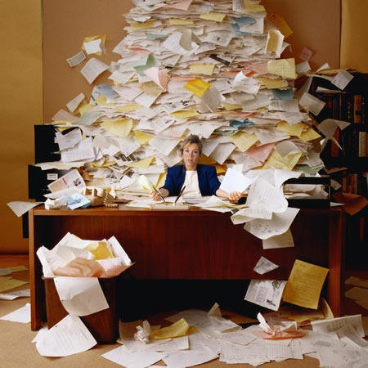
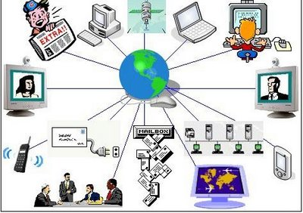
Information Overload

Slide 22
Coping With It!
“reserve large blocks of time on your calendar, don’t answer the phone, and return calls in short bursts once or twice a day” (Drucker, 1967)

Slide 23
Coping With It!
some combination of focusing, filtering, and forgetting
It requires a tremendous amount of self-discipline, and we can’t do it alone: in our teams and across the whole organization, we need to establish a set of norms that support a more productive way of working.
“Multitasking is not heroic; it’s counterproductive”
http://www.mckinsey.com/insights/organization/recovering_from_information_overload

Slide 24
Coping With It!
We have to admit, for example, that we do feel satisfied when we can respond quickly to requests and that doing so somewhat validates our desire to feel so necessary to the business that we rarely switch off. There’s nothing wrong with these feelings, but we need to consider them alongside their measurable cost to our long-term effectiveness. No one would argue that burning up all of a company’s resources is a good strategy for long-term success, and that is equally true of its leaders and their mental resources.

Slide 25
What kinds of information are there?
Text
books, periodicals, WWW, memos, ads
published/refeered
Film
Photos, other Images
Broadcast TV, Radio
Telephone Conversations
Databases

Slide 26
How much information is there? (Estimates courtesy of Hal Varian and Peter Lyman)
Original: http://www.sims.berkeley.edu/emc
Newer: http://www2.sims.berkeley.edu/research/projects/how-much-info-2003/

Slide 27
How Much Information?
Stored Information
Print
Film
Optical
Magnetic
Communicated
Internet
Broadcast
Phone
Mail

Slide 28
Print
Annual Production
Books 968,735 = 8 Terabytes (compressed image)
Newspapers 22643 = 25 Terabytes
Journals 40000 = 2 Terabytes
Magazines 80000 = 10 Terabytes
Office Documents 12x10^9 pages = 312 Terabytes
TOTAL 357 Terabytes

Slide 29
Print
Library of Congress Printed book collection
About 18 Million books
About 130 Terabytes (compressed image)
For all of LC we should also assume
13M photographs, 5MB each = 65 TB
4M maps, say 200 TB
500K files, 1GB each = 500 TB
3.5M sound recordings, ~2000 TB
Grand total: 3 petabytes (~3000 terabytes)
Books in Print (which you can buy TODAY)
3.2 Million titles
About 26 Terabytes

Slide 30
Film and Image
Film
Photographs = 410 Petabytes per year
Movies = 16 Terabytes (Commercial Production of about 4000 films)
X-Rays = 12 Petabytes

Slide 31
Optical Media
CD-Music 90,000 items = 58 TB
CD-ROM 3,000 items = 3 TB
DVD-Video 5,000 items = 22 TB
Total 83 TB

Slide 32
Magnetic Media
Audio Tape 184,200,000 = 184.2 Petabytes
Video Tape 355,000,000 = 1420
Floppy disks = 0.07
Removable disks = 1.69
Hard Disks = 500

Slide 33
Totals Stored Per Year
Medium Type of content Terabytes/Year Terabytes/Year
Upper Bound Lower Bound
Paper
Books 8 7
Newspapers 25 20
Periodicals 12 12
Office documents 312 312
SUBTOTAL 357 351
Film
Photographs 410,000 100,000
Cinema 16 16
X-Rays 12,000 12,000
SUBTOTAL 422,000 112,016
Optical
Music CDs 58 40
Data CDs 3 3
DVDs 22 22
SUBTOTAL 83 65
Magnetic
Camcorder 300,000 300,000
Disk drives 2,555,000 1,000,20
SUBTOTAL 2,855,000 1,300,200
TOTAL 3,277,440 1,412,632

Slide 34
Human Memory
Landauer 86: Human brain holds 200MB
looked at rate of information intake and rate of forgetting, and amount of information adults need for normal tasks
6B people on earth implies total memory of all people alive about 1,200 petabytes
Another way:
estimate that people take in a byte/sec
lifetime 250,000 days or 2B sec
result is 2 GB (doesn’t count synthesizing new info)

Slide 35
Summary
Administrivia
Why Information Retrieval

Slide 36
Next
Introduction to Information Retrieval

